Slide 1

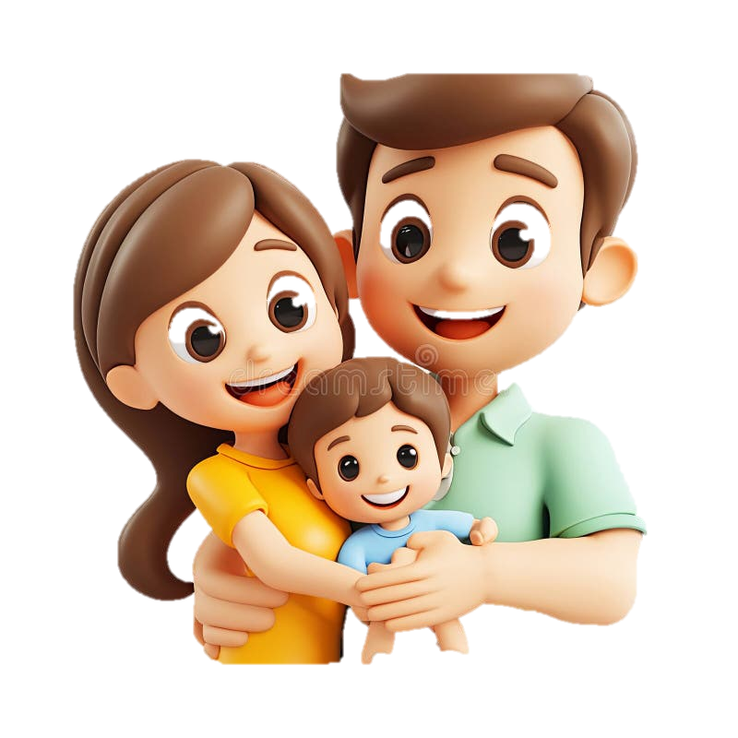

Others in my world
Safeena

Slide 2
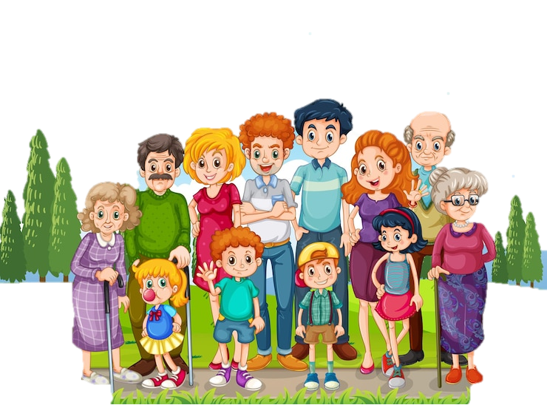
What is a Family?
• A family is a group of people who love and care for each other
• Families can look different
• Some families are big, some are small
• All families are special

Slide 3

People in My Family
• Parents (Mom and/or Dad)

Slide 4
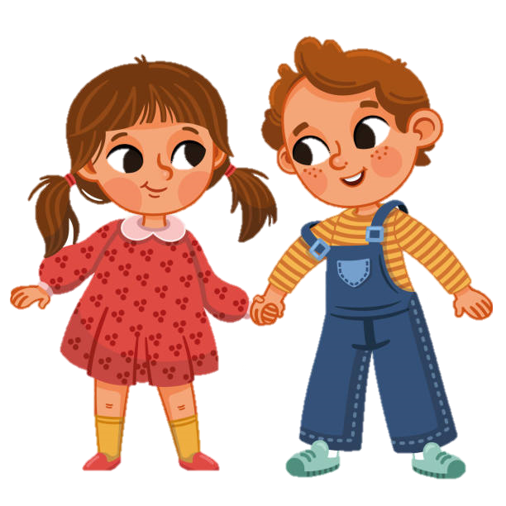
People in My Family
• Brothers and Sisters - Siblings

Slide 5
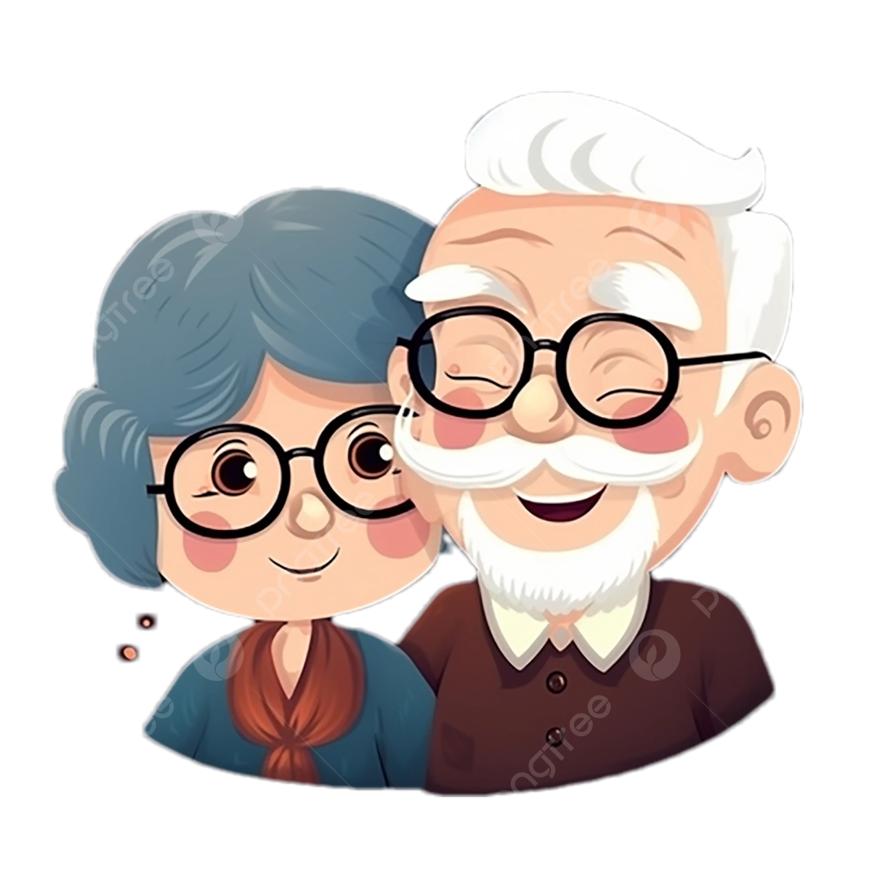
People in My Family
• Grandparents

Slide 6
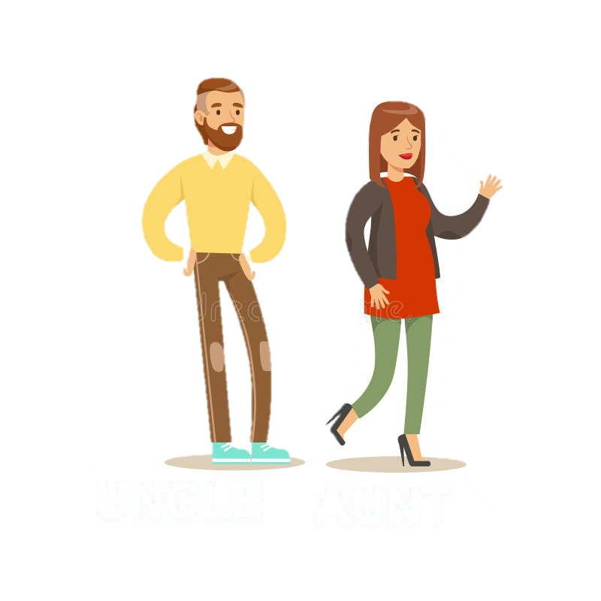
People in My Family
• Aunts and Uncles
• Cousins

Slide 7
Different Types of Families
• Some families have one parent
• Some families have two parents
• Some children live with grandparents
• Some families have adoptive parents
• Every family is unique and special

Slide 8
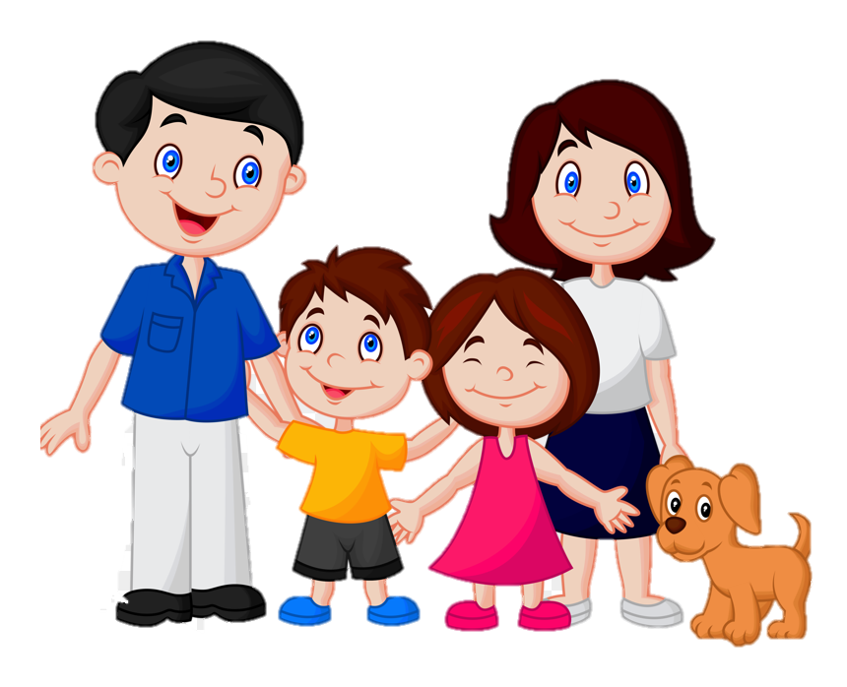
Nuclear family
A nuclear family has parents and children living together
Like mom, dad, and kids
They live in one home
They eat meals together
They take care of each other every day
Example: Mom, Dad, and two children

Slide 9
Joint Family
A joint family is a big family living together
Grandparents, parents, and children all in one home
Everyone helps take care of each other
They share meals and special times together
Many cousins might live together
Example: Grandma, Grandpa, Mom, Dad, Aunts, Uncles, and Cousins

Slide 10
Single parent family
A single parent family has one parent and children
Sometimes it's just mom and kids
Sometimes it's just dad and kids
They work together as a team
They give lots of love and support to each other
Example: Mom and her two children, or Dad and his child

Slide 11
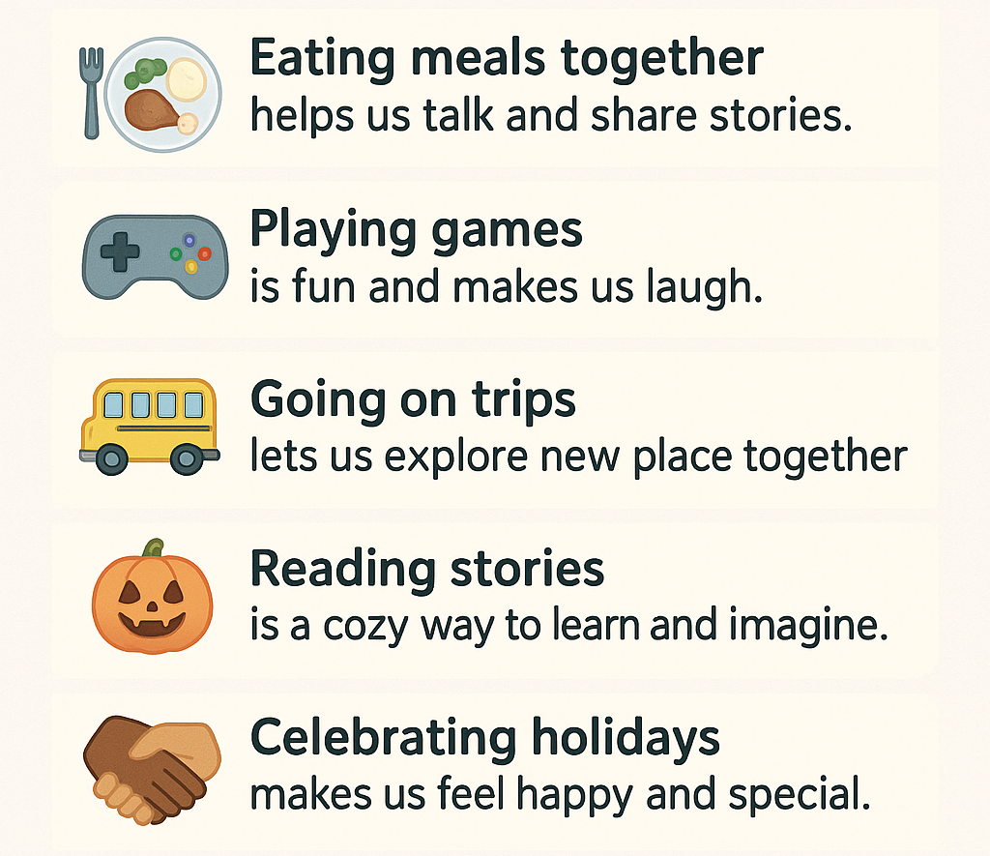
Family Activities

Slide 12
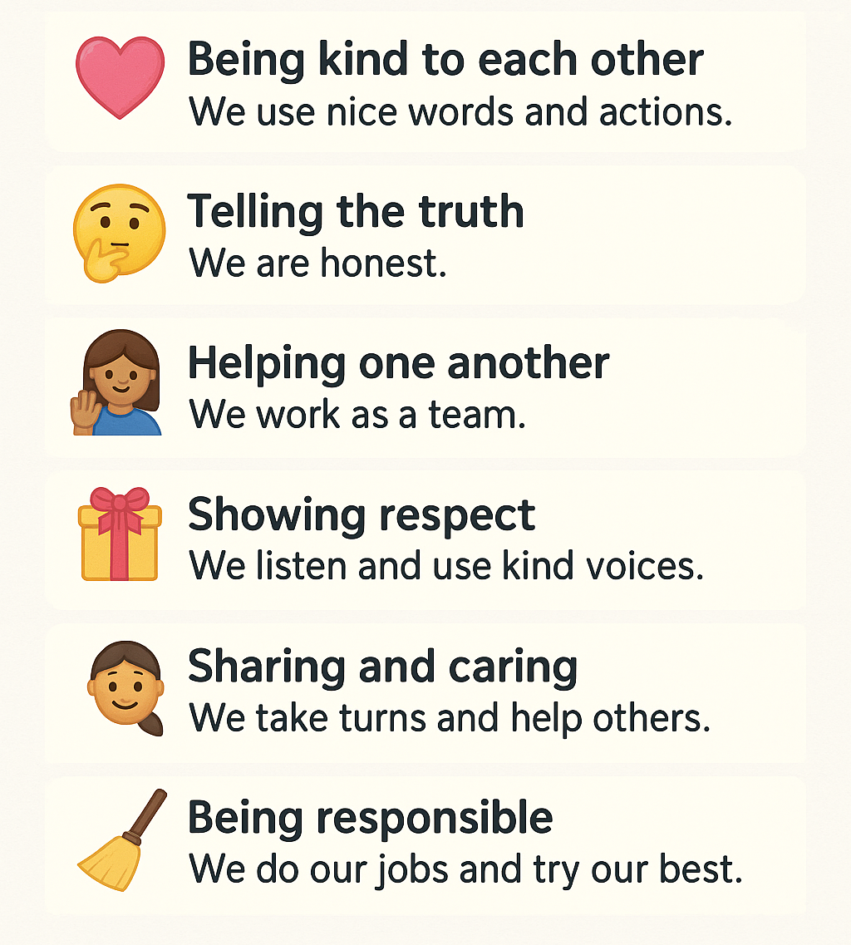
Family Values

Slide 13
How Families Help Each Other ?
• Doing chores together
• Taking care of each other when sick
• Helping with homework
• Making each other feel better
• Working as a tea

Slide 14
Special Family Times
• Birthdays
• Holidays
• Family dinners
• Weekend activities
• Vacations
• Family traditions

Slide 15
My Family Tree
• Draw your family members
• Write their names
• Show how everyone is connected
• Include special people in your life
• Everyone's family tree is different

Slide 16
Why Families are Important ?
• Families give us love
• Families keep us safe
• Families teach us important things
• Families make us happy
• Families make us who we are

